Slide 1
Sales Analysis Project
Superstore data
By Sanjana PM

Slide 2
Objective
To find key trends and give simple suggestions to help improve sales and profit.

Slide 3
Key Insights
Insight 1
Insight 2
Insight 3
The Technology category has the highest sum of profit when compared with the other categories.
The west region has the highest total sales (725457.8245).
The Furniture category has the least profit despite having moderate sales volume.

Slide 4
Recommendations
Prioritize Eureka Disposable Bags in marketing and sales efforts to boost sales.
Focus on the south region by identifying local market challenges,launching target promotions to close the performance gap between regions.
Focus on improving overall product sales since even low-selling products are showing up in the top 5.

Slide 5
Visual Representations

Slide 6
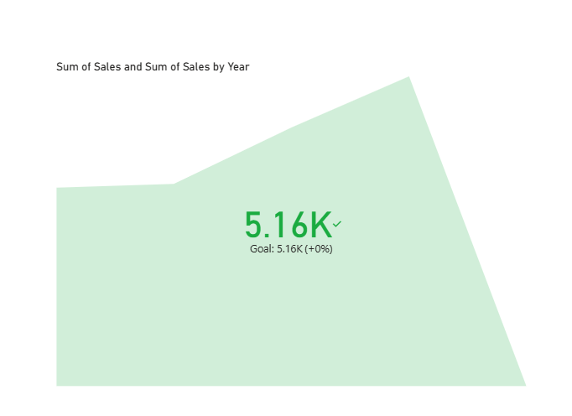
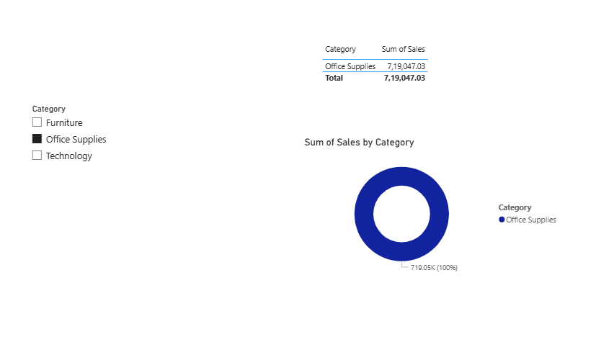
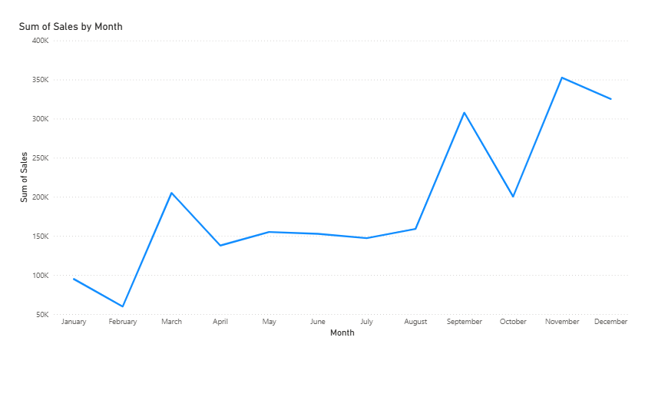
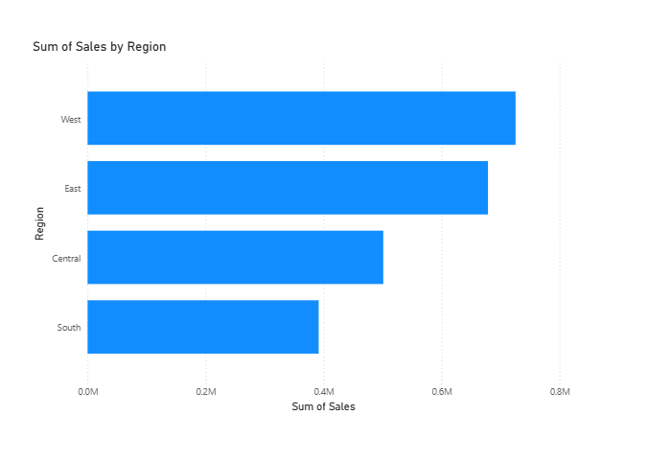

Slide 7
Tools used
Excel
PowerBI
Dataset: Superstore sales data

